Slide 1
Week 11 and 12 Presentation
Pauline Dang

Slide 2
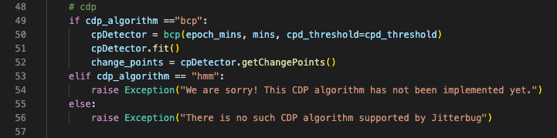
Jitter Detection
This code uses the bayesian change point detection system
It then stores the points in the data where the mean of an interval changes as change_points

Slide 3
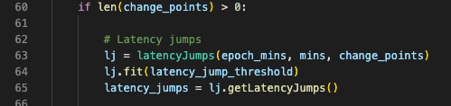
Then the code uses those changes points along with the min data set to see if there is a jump in the mean of the a time interval at the change point and the change point before it

Slide 4
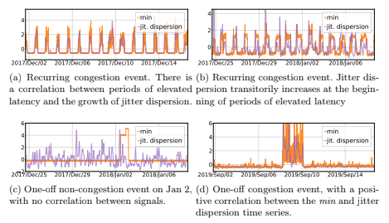
What I’m Struggling With
If Jitter is computed by the data of latency times, then how can it know where jitter is increasing. In this picture, the jitter dispersion is clearly significant different than in the min data file. However the difference is how we can assume that in ©, there is not congestion and could indicate another anomaly that would cause an increase in latency. As I understand it, the jitter is further analyzed using either ks or jd to obtain those variations.

Slide 5
Real Time Data Analysis Software
Aggregator - Gather real time data from multiple sources
Analytics Engine - Compares data values and streams while performing real time data analysis
Broker - Creates data availability
Stream Processor - Receives and sends data to execute logic and perform analytics in real-time

Slide 6
RTDA Limitations
What tool can I use to gather the data in real time?
How can I adapt the jitterbug code to run constantly?
What time intervals would I want to chose for the code to be running?
Since jitterbug filters the data in 15 minute intervals, would it be more helpful to use smaller intervals to have a more immediate response to congestion? It is simply impractical to run jitterbug on all latency times and because the time intervals are not consistent, it causes many errors in some of the change point detection software

